Slide 1
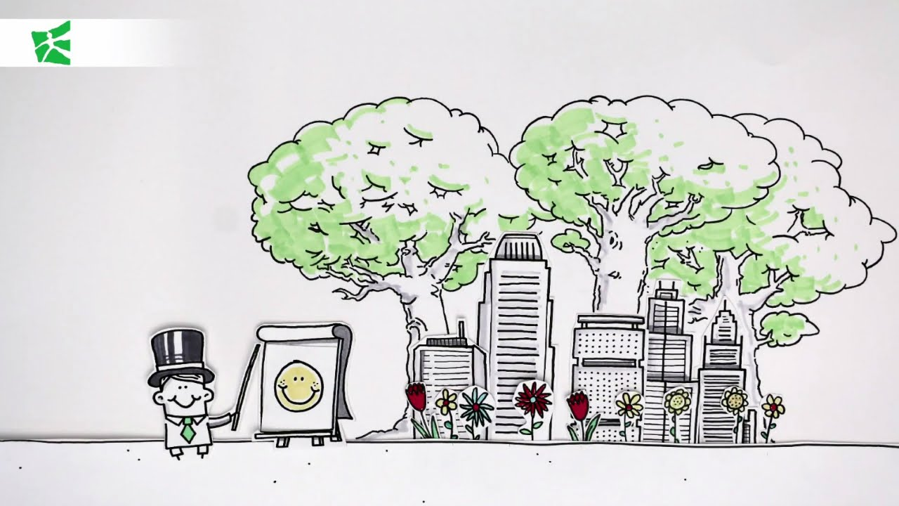
Public and Common Goods
Source: https://www.google.co.in/url?sa=i&rct=j&q=&esrc=s&source=imgres&cd=&cad=rja&uact=8&ved=0ahUKEwi90KS3-b_WAhVJLY8KHfXlD88QjRwIBw&url=https%3A%2F%2Fwww.youtube.com%2Fwatch%3Fv%3DtLGAQ4q_Sb0&psig=AFQjCNFLTZUHH27Z6q8jLHygzodmmzmMWA&ust=1506415565707282

Slide 2
Classifying Goods ref
Excludable vs Non-excludable Goods
Excludable: A good is excludable if only the people who pay for the good are able to enjoy its benefits.
Non-excludable: A good is non-excludable if many people can enjoy the benefits of a good whether they paid for it or not.

Slide 3
Rival vs Non-rival Goods
Rival: A good is a rival good if one person’s use of the good diminishes or eliminates other people’s enjoyment of the good.
Non-rival: A good is non-rival if one person’s use does not impact another person’s enjoyment of the good.

Slide 4

Public vs Private Goods
Private good: A good that is excludable and rival.
- These are goods that you can only consume if you buy them
Public good: A good that is non-excludable and non-rival.
- Can be consumed / used simultaneously by everyone.
Public vs. Private Goods (08.13mm)
Credit:Conservation Strategy Fund, Public vs. Private Goods, Source https://www.youtube.com/watch?v=E1v5eRs0_fw

Slide 5
Common Goods
a good that is non-excludable, but rival.
Tragedy of the Commons - Tragedy of the Commons │ The Problem with Open Access - 03.26mm (https://youtu.be/WYA1y405JW0)
- Common goods get over-used, and can diminish or disappear absent of any regulation.
- Non-excludable: allows anyone to use the good.
- Rival: people’s use of the good diminishes its usefulness.

Slide 6

Cost Benefit Analysis (CBA)
Estimates and totals up the equivalent money value of the benefits and costs to the community of projects to establish whether they are worthwhile
Intro to Cost-Benefit Analysis - (04.35mm)
Credit:Conservation Strategy Fund, Public vs. Private Goods, Source https://www.youtube.com/watch?v=7tdKkeNClPE

Slide 7
Purpose of CBA ref
To determine if an investment/decision is sound (justification/feasibility) – verifying whether its benefits outweigh the costs, and by how much;
To provide a basis for comparing projects – which involves comparing the total expected cost of each option against its total expected benefits.

Slide 8
Principles of CBA ref
There must be a common unit of measurement
CBA valuations should represents Producers or Consumers
Benefits are usually measured by Market Choices
Gross benefits of an increase in consumption is an area under the demand curve
Some measurement of benefits require valuation of human life

Slide 9
Principles of CBA ref
6. The analysis of the project involves with versus without comparison
7. CBA involves a particular study area
8. Double counting of benefits or cost must be avoided
Decision criteria of project

Slide 10
Key CBA Indicators
NPV (net present value)
PVB (present value benefits)
PVC (present value cost)
BCR (benefit cost ratio)
Net benefit = (PVB - PVC)
NPV/k (where k is the levels of funds available)

Slide 11
Key CBA Process ref
List alternative projects/programs.
List stakeholders.
Select measurement(s) and measure all cost/benefit elements.
Predict outcome of cost and benefits over relevant time period.
Convert all costs and benefits into a common currency.
Apply discount rate.
Calculate net present value of project options.
Perform sensitivity analysis.
Adopt recommended choice.

Slide 12
CBA Evaluation ref
CBA attempts to measure the positive or negative consequences of a project, which may include:
Effects on users or participants
Effects on non-users or non-participants
Externality effects
Option value or other social benefits.
Case Study: CBA for Highway Improvement project - http://www.sjsu.edu/faculty/watkins/cba.htm

Slide 13
Extra Resources:
Cost-Benefits Scenarios (04.48mm) - https://youtu.be/0kakVKN1mi8
What marginal benefit equals marginal cost means in economic terms - (04.15mm) https://www.youtube.com/watch?v=NGuiko42Qsk
Environmental Economics (09.20mm) - https://youtu.be/dHn_bNfbllA

